Slide 1

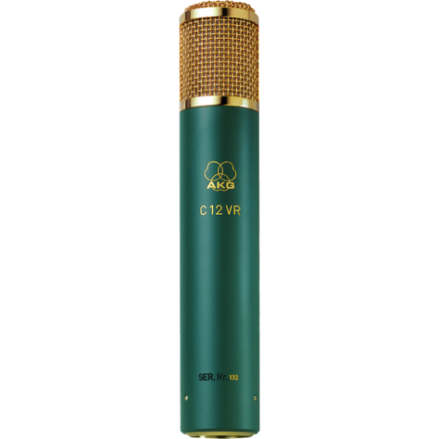
음향 시스템 사양서
REFERENCE MULTI-PATTERN TUBE CONDENSER MICROPHONE
AKG : C12 VR
SPECIFICATIONS
frequency bandwidth : 30 - 20000 Hz
noise level : 22 dB-A
Sensitivity : 10 mV/Pa
Signal to Noise : 72 dB-A
Preattenuation Pad : -10; -20 dB
Bass cut filter : 100; 130 Hz
Electrical impedance : 200 Ohms
Recommended load impedance : 1000 Ohms
Polar Patterns : Cardioid, Omnidirectional, and Figure of eight
Audio Output Type : Balanced XLR
Dimension (Height x Diameter)mm : 225 x 42
Weight : 680g
FEATURES
따뜻함, 명료함, 현장감 재생 및 전달
9종류의 다양한 지향 특성
저역 롤-오프 필터
선택 가능한 감쇄 패드장착

