Slide 1

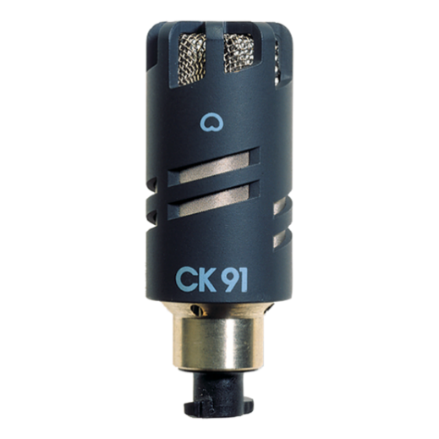
음향 시스템 사양서
CARDIOID CONDENSER MICROPHONE CAPSULE
AKG : CK91
SPECIFICATIONS
Audio frequency bandwidth : 20 - 20000 Hz
Equivalent noise level : 17 dB-A
Sensitivity : 10 mV/Pa
Signal to Noise : 77 dB-A
Electrical impedance : 200 Ohms
Polar Pattern : Supercardioid
Powering Interface : 9 to 52 V , 2 mA
Finish : dark gray
Audio Output Type : bayonet mount
Dimension (Height x Diameter)mm : 51 x 19
FEATURES
카디오이드 극성 패턴
부드럽고 균형 잡힌 주파수 응답
소형 콘덴서 캡슐

