Slide 1

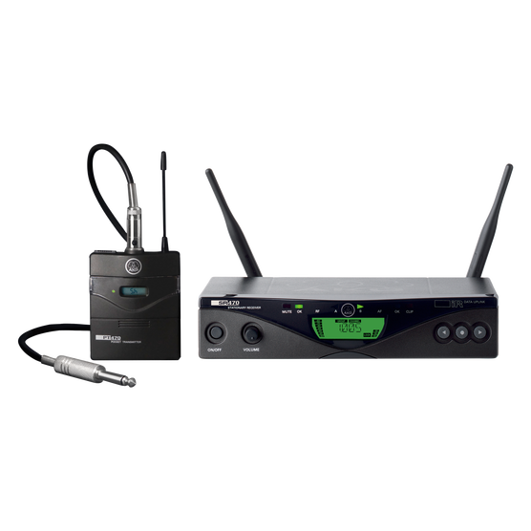
음향 시스템 사양서
WIRELESS MICROPHONE SYSTEM
AKG : WMS470 INSTRUMENTAL SET
SPECIFICATIONS
package includes : 1 x SR470 Receiver
1 x PT470 Body-pack transmitter
1 x MKG L Instrument cable
1 x Rack mount kit
1 x Universal power supply with US/UK/EU adapter
1 x AA size battery
2 x Antennas
1 x Belt clip
Model : SR470
Switching bandwidth : 30.5 MHz
Diversity System : Microprocessor-controlled diversity
Modulation : Wideband FM
Audio bandwidth : 35 – 20000 Hz (± 3 dB)
T.H.D : <= 0.3 %
SNR (A-weighted) : typ. 120 dB(A)
Audio outputs : 1 x XLR sockets balanced
1 x TS 1/4” / 6.3 mm jack sockets unbalanced
Standard Accessories : 2 UHF antennas, power supply, rack mount kit
Dimension (H x W x D)mm : 44 x 202 x 190
Weight : 972g
FEATURES
자동 주파수 설정
최대 16개의 사전 프로그래밍 된 주파수 제공
파일럿 톤을 통한 시동 소음을 방지
최대 14시간의 배터리 수명 및 배터리 상태 정보
2색 디스플레이 백라이트

Slide 2
음향 시스템 사양서
WIRELESS MICROPHONE SYSTEM
AKG : WMS470 INSTRUMENTAL SET
SPECIFICATIONS
Model : PT470
frequency bandwidth : 35 to 20000 Hz
Signal to Noise : 120 dB-A
THD at 1 kHz : 0.7 Prozent
Peak deviation : 48 kHz
Switching bandwidth : 30 MHz
Recommended simultaneous channels : 24
Radio range (Line of sight) : 100m (depending on antenna system)
Nominal deviation : 20 kHz
Radio Output Power (min/max) : 10 to 50 mW
Transmitter Synchronization : Infrared
Audio Input Type : Mini XLR
Mute Switch Interface Type : Jack Mono (1/4")
Battery type : LR6 AA alkaline , HR 6 AA (NiHM) , FR 6 AA lithium

